Slide 1

Machine Translation

Slide 2
Contents
What is Machine Translation?
Rule-Based Machine Translation
Statistical Machine Translation
Neural Machine Translation (NMT)
NMT Architecture
Training NMT Models
Evaluation Metrics

Slide 3
What is Machine Translation?
Machine translation is the automated process of translating text from one language to another using computational methods and algorithms.
It aims to enable communication between people who speak different languages by converting text from a source language into a target language.

Slide 4
What is Machine Translation?
Importance of Machine Translation
  Global Communication
    Machine translation allows people from different linguistic backgrounds to communicate and share information effortlessly, fostering global connectivity.
  Business and Commerce
    In the business world, machine translation facilitates international trade, collaboration, and marketing by making content accessible to diverse audiences.
  Education and Research
    Scholars and researchers can access information across languages, promoting knowledge exchange and academic cooperation.
  Tourism and Travel
    Travelers can navigate foreign countries more easily, understanding signs, menus, and information in their native language.
  Emergency Situations
    Machine translation can aid communication during emergencies, such as natural disasters or medical crises, when language barriers can hinder information dissemination.
  Cultural Exchange
    Literature, art, and cultural works can reach wider audiences, contributing to the exchange of cultural knowledge and ideas.

Slide 5
What is Machine Translation?
Approaches to Machine Translation
  Rule-Based Approach
    This approach uses linguists' expertise to create linguistic rules and dictionaries for translation. While accurate for simple sentences, it struggles with idiomatic expressions and complex structures.
  Statistical Machine Translation (SMT)
    SMT uses large bilingual corpora to learn statistical relationships between words and phrases in different languages. It produces acceptable translations but may struggle with rare or unseen phrases.
  Neural Machine Translation (NMT)
    NMT employs deep learning techniques, particularly neural networks, to model the translation process. It has led to significant improvements in translation quality by capturing complex linguistic patterns.
  Transformer-Based NMT
    The transformer architecture, popularized by models like BERT and GPT-3, has revolutionized NMT. It captures contextual information better, making it suitable for various language pairs and domains.

Slide 6
Rule-Based Machine Translation
Rule-Based Machine Translation (RBMT) was one of the early approaches to machine translation, developed before the advent of sophisticated machine learning techniques.
RBMT relies on human linguists and experts to create a set of linguistic rules that guide the translation process.

Slide 7
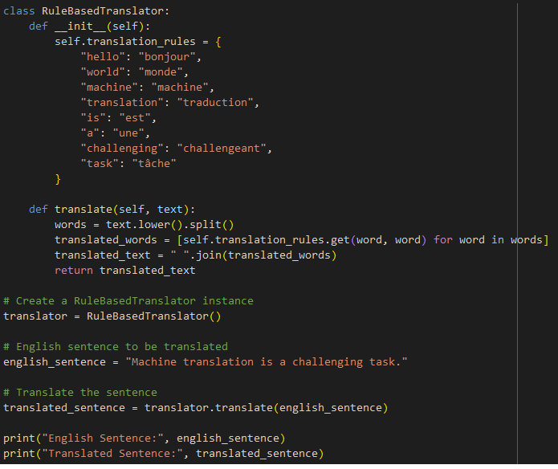
Rule-Based Machine Translation
Example
In this example:
We define a RuleBasedTranslator class with a dictionary of translation rules.
The dictionary maps English words to their corresponding French translations.
The translate method splits the input text into words, applies the translation rules, and returns the translated text.
We create an instance of RuleBasedTranslator.
We provide an English sentence that we want to translate.
We call the translate method to obtain the translated sentence.

Slide 8
Rule-Based Machine Translation
Limitations of Rule-Based Machine Translation
  Idioms and Cultural Nuances
    RBMT struggles with translating idiomatic expressions, metaphors, and cultural nuances that do not have direct equivalents in the target language. These nuances often require a deep understanding of the cultural context, which rule-based systems may lack.
  Coverage
    Creating comprehensive sets of rules for all possible language combinations, contexts, and vocabulary is challenging and time-consuming. RBMT systems may not cover specialized or domain-specific terminology.
  Ambiguity
    Languages often have ambiguous words or phrases that require context to be correctly translated. RBMT struggles with resolving such ambiguities accurately.
  Scalability and Maintenance
    Expanding and maintaining rule sets for new language pairs or languages can be labor-intensive and may not scale well as the complexity of the language increases.
  Limited Adaptability
    RBMT systems cannot learn from data or adapt to new language patterns automatically. Any improvements or updates require manual intervention from linguists.
  Translational Variability
    Languages may exhibit significant variability in how words and phrases are used, making it difficult to capture all possible variations using rules.

Slide 9
Statistical Machine Translation
Statistical Machine Translation (SMT) represents a significant advancement in the field of machine translation.
Unlike rule-based approaches, SMT systems learn translation patterns and relationships directly from parallel corpora, enabling more data-driven translation processes.

Slide 10
Statistical Machine Translation
Learning Translation Probabilities from Parallel Corpora
  In SMT, translation probabilities are learned from large sets of bilingual text pairs, known as parallel corpora.
  The fundamental idea is to observe how words, phrases, and sentences are translated from a source language to a target language in the parallel data.
  By analyzing these translation patterns, the SMT system calculates probabilities to guide the translation process.

Slide 11
Statistical Machine Translation
Importance of Alignment Models
  To learn these translation probabilities, SMT systems use alignment models that identify which words or phrases in the source language correspond to those in the target language.
  These alignment models help establish word-to-word or phrase-to-phrase mappings between the source and target languages.

Slide 12
Statistical Machine Translation
Phrase-Based Translation
  One of the key advancements in SMT is the introduction of phrase-based translation.
  Instead of translating words individually, SMT systems consider phrases or small groups of words as translation units.
  This approach allows for more flexibility in handling phrases, idioms, and non-compositional expressions that rule-based systems struggled with.

Slide 13
Statistical Machine Translation
SMT Workflow
  Parallel Corpora
    SMT systems require large bilingual parallel corpora consisting of source language sentences and their corresponding translations in the target language.
  Alignment Models
    The alignment models identify word or phrase alignments between the source and target sentences. These models help capture the relationships between words in different languages.
  Translation Probabilities
    Based on the observed alignments, SMT systems calculate translation probabilities for different translation units (words, phrases). These probabilities guide the translation process.
  Decoding
    During translation, SMT systems use these probabilities to generate translations for input sentences in the source language. The translation process involves selecting the most likely target phrases given the source phrases and their probabilities.
  Phrase-Based Approach
    SMT introduces a phrase-based translation approach, where translations are generated for phrases rather than individual words, allowing for improved handling of language nuances and expressions..

Slide 14
Neural Machine Translation (NMT)
Neural Machine Translation (NMT) marks a significant breakthrough in machine translation, representing a departure from rule-based and statistical approaches.
NMT leverages deep learning techniques to model and learn the translation process directly from data, leading to improved translation quality and handling of complex language structures.

Slide 15
Neural Machine Translation (NMT)
Deep Learning and Sequence-to-Sequence Models
  NMT employs a class of deep learning models known as sequence-to-sequence (seq2seq) models. These models consist of two main components: an encoder and a decoder.
  Encoder: The encoder processes the input sentence in the source language and generates a context vector that captures the semantic representation of the input.
  Decoder: The decoder takes the context vector generated by the encoder and generates the translated sentence in the target language.

Slide 16
NMT Architecture
Encoder
The Encoder processes the input sentence in the source language and transforms it into a fixed-size context vector or hidden state.
This context vector serves as a compressed representation of the input sentence's meaning. The encoder's role is to capture the semantic and syntactic information of the source sentence.
Attention Mechanism
The Attention Mechanism is a crucial component that aligns the input and output sequences during translation. It allows the model to focus on different parts of the input sentence while generating each word of the translated output. This attention mechanism enables the model to effectively capture the relationships between words and phrases in both languages, accommodating long-range dependencies.
Decoder
The Decoder takes the context vector generated by the encoder and generates the translated output sentence in the target language. It operates in a step-by-step manner, generating each word of the translation sequentially. At each step, the decoder's hidden state, the context vector from the attention mechanism, and the previously generated words guide the prediction of the next word in the target language.

Slide 17
Training NMT Models
1. Parallel Corpora
NMT models are trained on bilingual data, where each sentence in the source language corresponds to a sentence in the target language. These pairs of sentences form the parallel corpora, which are essential for the model to learn translation relationships.
2. Loss Minimization
The primary objective during training is to minimize the loss, which quantifies the difference between the model's predicted translations and the actual target translations. The loss function guides the model's learning process to generate translations that align well with the target translations in the training data.

Slide 18
Training NMT Models
3. Training Steps
Input Encoding:
  The source language sentences are tokenized and encoded by the Encoder, generating context vectors.
Attention Mechanism
  The attention mechanism calculates attention weights to align input and output sequences.
Decoding
  The Decoder generates translations word by word, predicting the next word based on the context vector and attention mechanism's context.
Loss Calculation
  The predicted translations are compared to the target translations in the training data, and a loss is calculated. This loss measures the discrepancy between the predicted and actual translations.
Backpropagation
  The gradients of the loss with respect to the model's parameters are calculated using backpropagation. These gradients indicate how the model's parameters should be adjusted to reduce the loss.
Gradient Descent
  The model's parameters are updated using gradient descent. This process iteratively adjusts the parameters in the direction that reduces the loss.

Slide 19
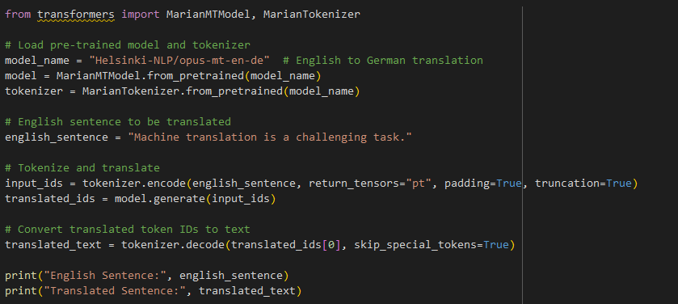
Example
We use the Hugging Face Transformers library to load a pre-trained machine translation model for English to German.
We provide an English sentence that we want to translate.
We tokenize the English sentence using the tokenizer and convert it to input IDs.
We use the pre-trained model to generate translated token IDs.
Finally, we decode the translated token IDs to obtain the translated text in German.

Slide 20
Evaluation Metrics
BLEU (Bilingual Evaluation Understudy):
  BLEU is a widely used metric that measures the quality of machine-generated translations by comparing them to one or more reference translations.
  It calculates a score between 0 and 1, where higher scores indicate better translation quality.
  BLEU focuses on precision by assessing how many n-grams (word sequences) in the generated translation match n-grams in the reference translations.

Slide 21
Evaluation Metrics
METEOR (Metric for Evaluation of Translation with Explicit ORdering):
  METEOR is another evaluation metric that considers not only word overlap but also synonyms and paraphrases.
  It takes into account various aspects of translation quality, including precision, recall, stemming, synonymy, and word order.
  METEOR provides a score between 0 and 1, where higher scores indicate better translation quality.

Slide 22
Evaluation Metrics
ROUGE (Recall-Oriented Understudy for Gisting Evaluation):
  ROUGE is a family of evaluation metrics designed for automatic summarization and machine translation.
  It evaluates the overlap of n-grams (usually up to 4-grams) between the generated translation and the reference translations.
  ROUGE metrics, such as ROUGE-N (n-gram overlap) and ROUGE-L (longest common subsequence), provide insights into the precision and recall of translation output.

Slide 23
Practice
Instructions
  In this assignment, you'll work with machine translation using a pre-trained model and evaluate its performance using appropriate metrics.
Tasks
  Task 1: Machine Translation
    Choose a language pair for translation (e.g., English to French, Spanish to English).
    Load a pre-trained machine translation model from the Hugging Face Transformers library for the chosen language pair.
    Implement a function that takes an English sentence as input and generates a translated sentence using the loaded model.
  Task 2: Evaluation
    Collect a set of reference translations for a diverse set of English sentences.
    Implement a function that evaluates the translated sentences from Task 1 against the reference translations.
    Calculate and report evaluation metrics such as BLEU score, ROUGE score, or METEOR score.

Slide 24
Q & A

